Slide 1
Are You an Accident of Nature?
Part 7
No Information by Chance -
Common Sense

Slide 2
Creation vs. Evolution
Bible says God made all initial kinds of creatures
Evolution says that life sprang from non-life by accident, violating:
  Information science
  Chemistry
  Law of Abiogenesis (Pasteur)
  2nd Law of Thermodynamics – entropy
Notes:
Law of Abiogenesis – Life never comes from non-life. Louis Pasteur
Billions of canned foods each year depend on this.
Organic chemistry – when amino acids occur in nature, right and left handed amino acids occur in equal numbers. But proteins are entirely made up of left handed amino acids. The presence of a single right handed AA in your protein would mess it up. Likewise, life uses only right-handed sugars, but sugars occur equally in both right and left-handed forms in nature. How can this be? Oxygen is the enemy of DNA; without a cell and nuclear membrane, bye-bye DNA.

Slide 3
Example - Complex Specified Information
In the beginning God created the heavens and the earth. The earth was without form, and void; and darkness was on the face of the waters. And the Spirit of God was hovering over the face of the waters. Then God said, “Let there be light”; and there was light.
259 characters - similar to medium protein

Slide 4
It is a mathematical fact that the DNA information for the simplest life could not have been created by:
Chance + Natural selection = Life

Slide 5
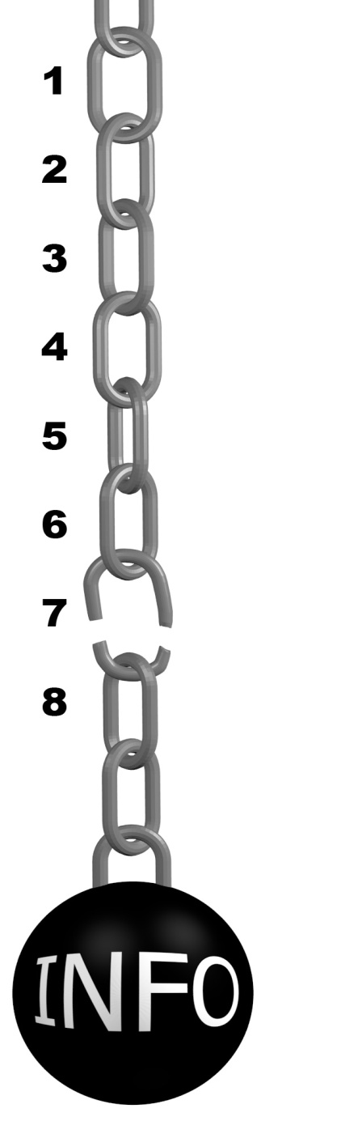
Information Chain
8 Essential Parts
Not one happens by chance

Slide 6
Information Requirements
What is required to:
- Create
- Store
- Duplicate
information?

Slide 7
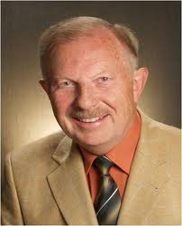
Dr. Werner Gitt
Retired Director and Professor
of Information Science

Slide 8
Dr. Werner Gitt
Physikalisch-Technische Bundesanstalt, Germany's prestigious national institute for natural and engineering sciences.

Slide 9
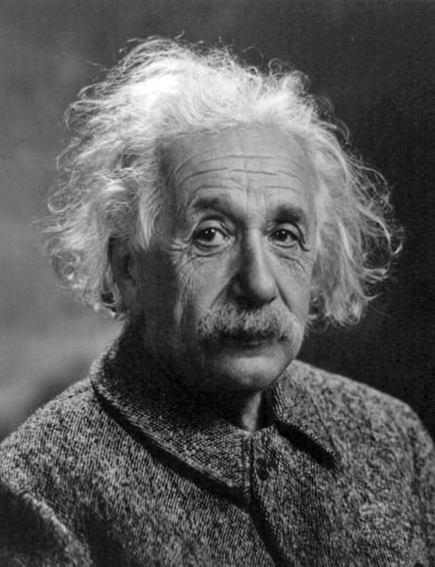
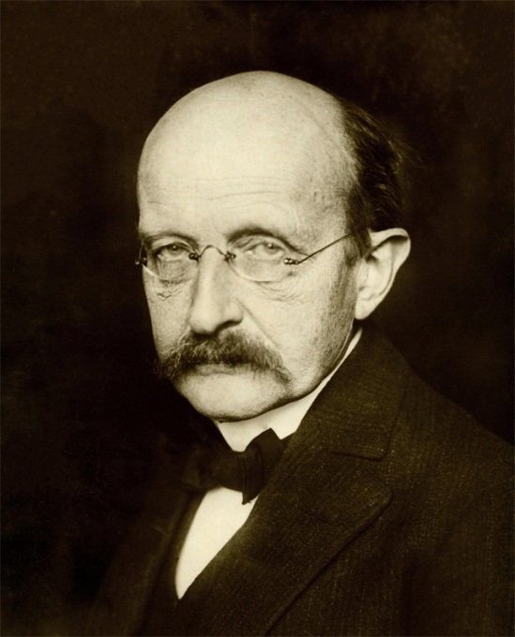
Max
Planck
Albert
Einstein
Former Board of Directors

Slide 10

Life’s Information Chain
8 Essential Parts
None happen by chance

Slide 11
Create a stable medium to hold the message
Create a symbolic code - alphabet
Assign meanings to patterns of the symbols “fish”
Create a punctuation syntax
(where does a word, protein, or gene start and end?)
Create information to regulate protein production, “the voice of information”. It is not enough to “know” and to “speak” words. The right mixture and timing of words is necessary to get an intelligent, useful sentence. Similarly, proteins must be produced at:
a) the correct place, b) time, c) amounts
For example:
a) Producing digestive acids (bile) in the brain would be fatal.
(wrong place)
b) Producing the hormones that trigger child birth too soon or too late would be fatal (wrong time)
c) Producing insufficient proteins (for example, insulin) can be fatal. (wrong amount)
Create a mechanism to write the message on the DNA (or paper, or DVD, etc.)
Guess which symbolic letters to use (E – V – I – L) or ( L – I – V – E ) ?
AND arrange them in the correct order.
Create mechanism to read the information and duplicate both the information and the cell machinery that produces it.

Slide 12
1 - Create something stable
to hold the information
Paper
DVD
DNA (needs cell to survive)
Notes:
Picture yourself walking through an uninhabited jungle. You won’t find a newspaper or DVD to write information on. Why? They do not occur naturally and if they were there, they would break down. DNA is far more complex that a piece of paper. Oxygen is the enemy of DNA.
A nail will rust if left outside – this is a destructive process due to oxidation.
The same thing will happen to DNA, destroying its information. DNA needs a cell to survive. Some like to think that RNA came before DNA, but RNA is more easily destroyed than DNA.
A recent finding by Penn State is that an ancient rock layer shows that the early atmosphere contained oxygen.
http://news.psu.edu/story/178269/2009/03/24/deep-sea-rocks-point-early-oxygen-earth Penn State News
Deep sea rocks point to early oxygen on earth
March 24, 2009
University Park, Pa. -- Red jasper cored from layers 3.46 billion years old suggests that not only did the oceans contain abundant oxygen then, but that the atmosphere was as oxygen rich as it is today, according to geologists.

Slide 13
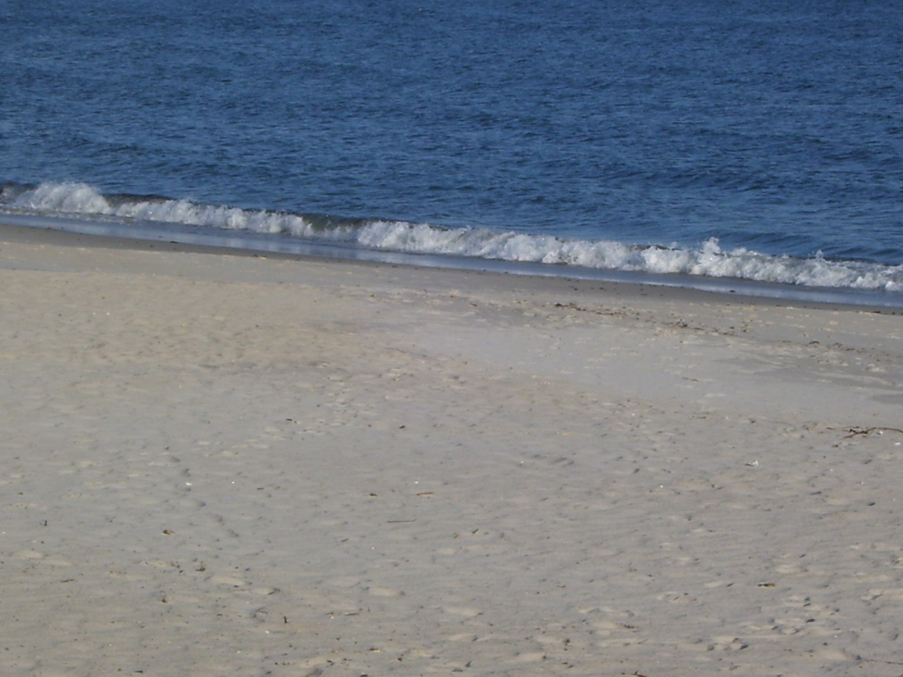

Slide 14
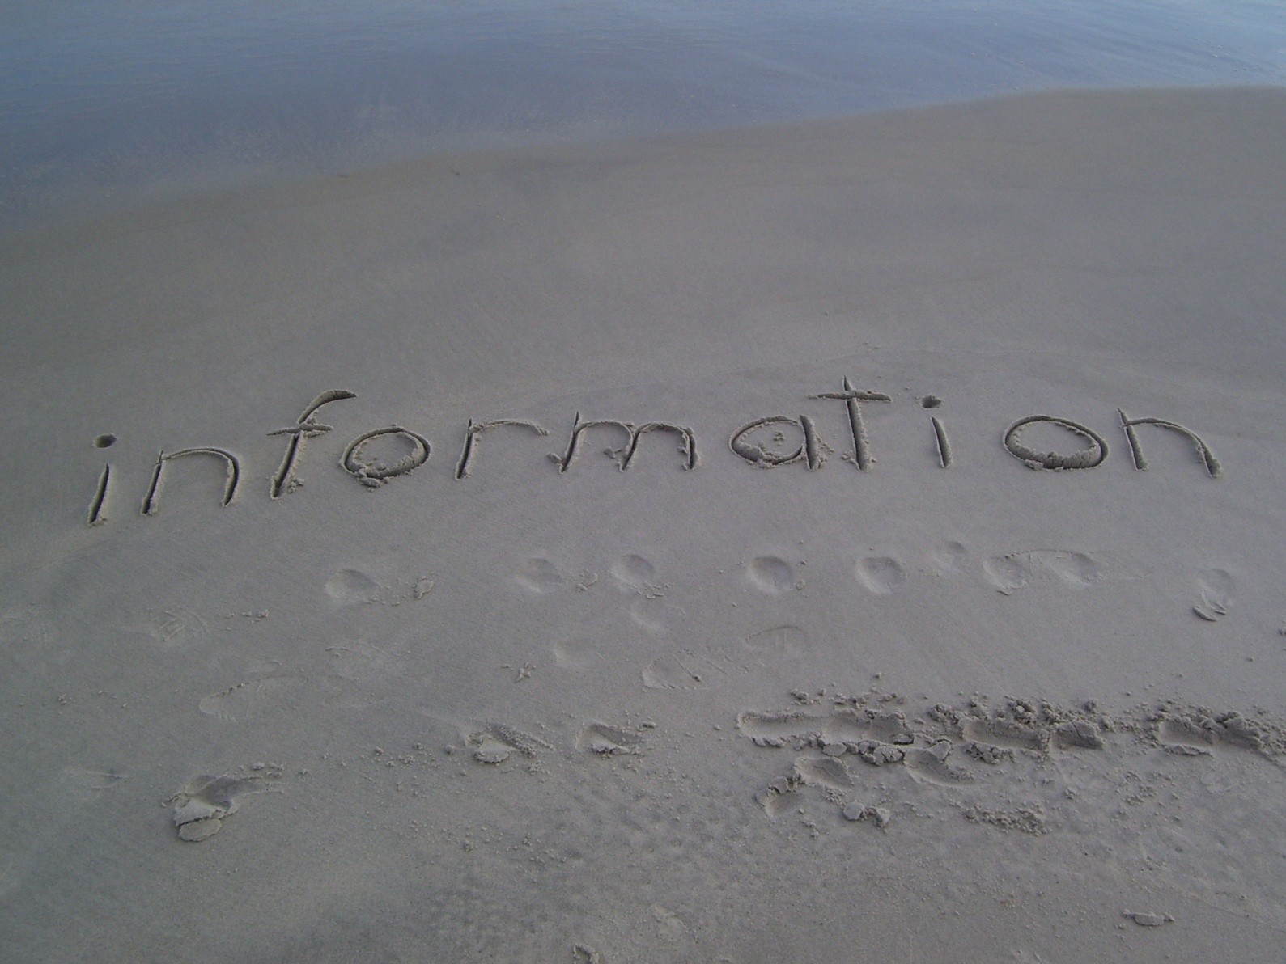
Information in Beach Sand

Slide 15
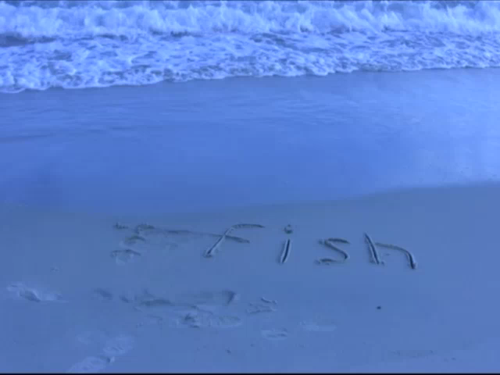

Slide 16
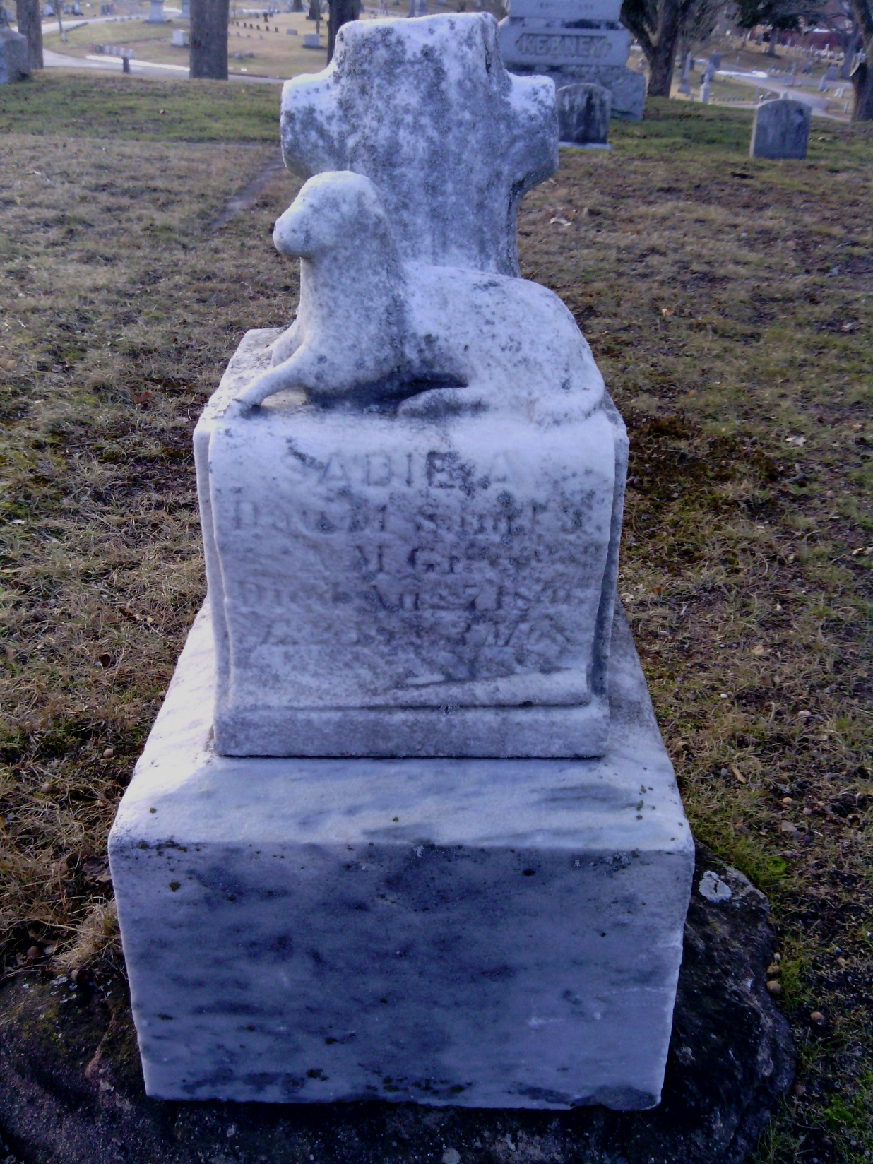
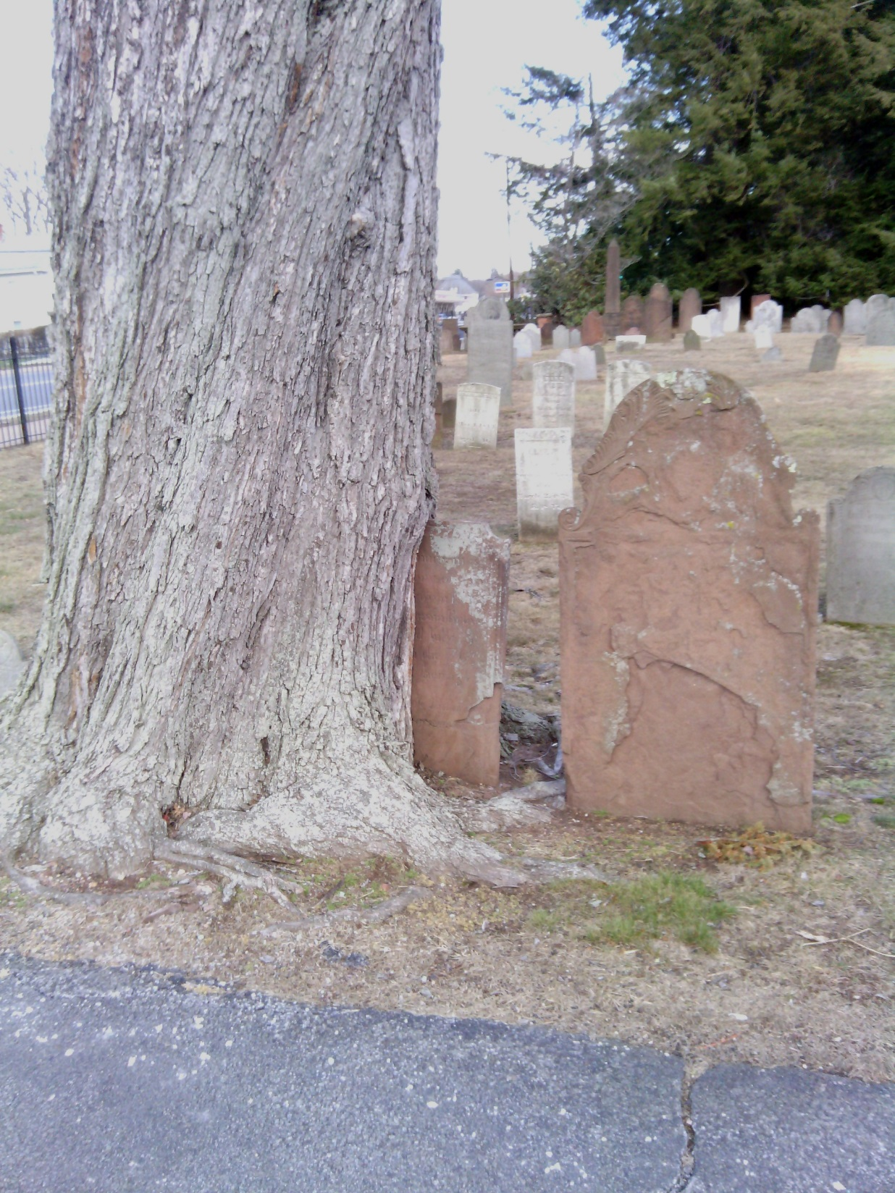

Slide 17

1 Create a stable medium to hold the information

Slide 18

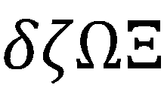
2 - Create Symbolic Code
(alphabet)
a-b-c

Slide 19
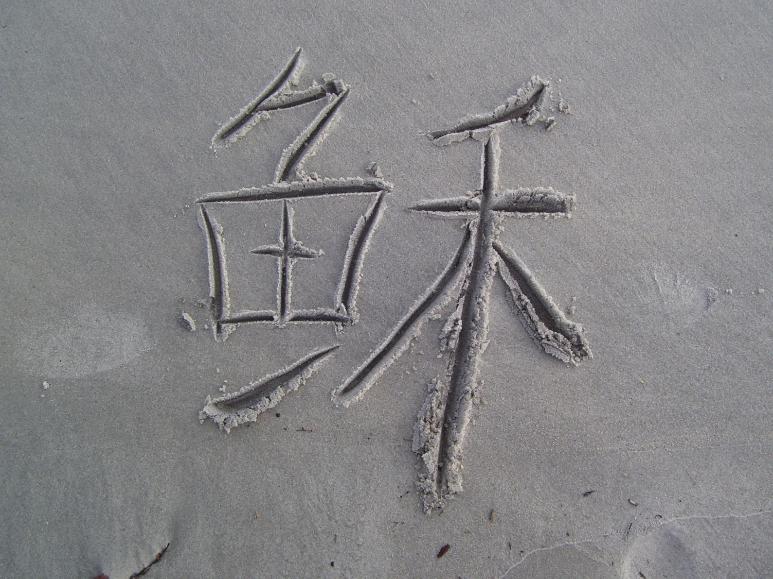
Information Codes are Distinctive
Not formed by random processes.
Need to be repeated accurately.

Slide 20
2 Create a symbolic code (alphabet)

Slide 21
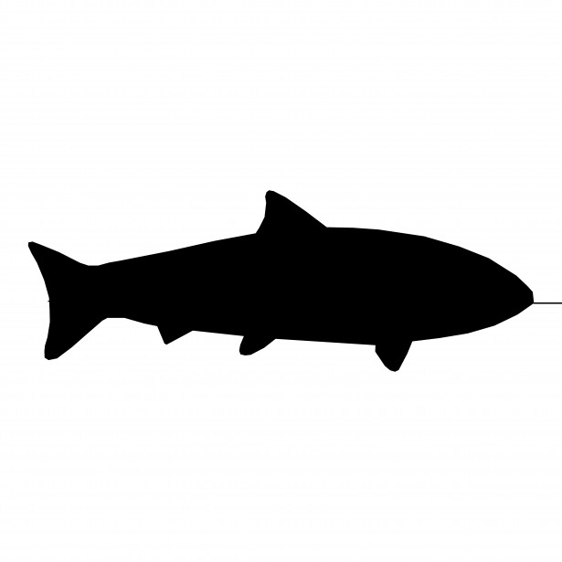
3 - Assign meanings to
patterns of the symbols
z-2-y-p-u
F-i-s-h
i-n-t-r-x-8
P-T-L
Notes:
Nature does not associate patterns of symbols with meanings.
It does not remember what meaning is needed, then faithfully come up with the correct pattern.

Slide 22
Assign meanings to patterns of symbols
AND !
repeatedly use same pattern for same meaning

Slide 23
4 - Create a punctuation
syntax
Where does a word,
protein, or gene
start and end?

Slide 24
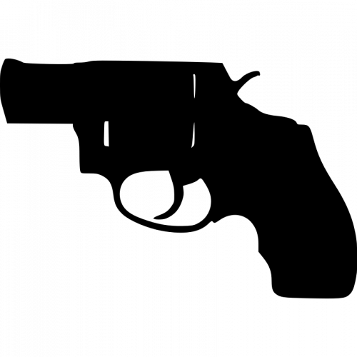
Shall I spare his life?

Slide 25
Do not kill him.
Do not. Kill him.

Slide 26
4 Create a
punctuation
syntax
Notes:
In nature, there is no reason why punctuation syntax would be created and used consistently. But this is required for information.

Slide 27
5 Create system to
control info flow
(protein production)

Slide 28
Create information to regulate protein production, “the voice of information”.
It is not enough to “know” and to “speak” words.

Slide 29
We need the right mixture and timing of words to get a useful sentence.

Slide 30
Proteins must be produced at correct:
Place
Time
Amounts

Slide 31
Producing digestive acids (bile) in the brain would be fatal.
(wrong place)
Producing the hormones that trigger child birth too soon or too late would be fatal.
(wrong time)
Producing not enough proteins (e.g. insulin) can be fatal.
(wrong amount)

Slide 32
5 Create system to
regulate proteins
Notes:
Hormones for childbirth. Too soon, baby is dead. Too late, mother and baby are dead.

Slide 33
6 - Create a mechanism
to write the
information

Slide 34
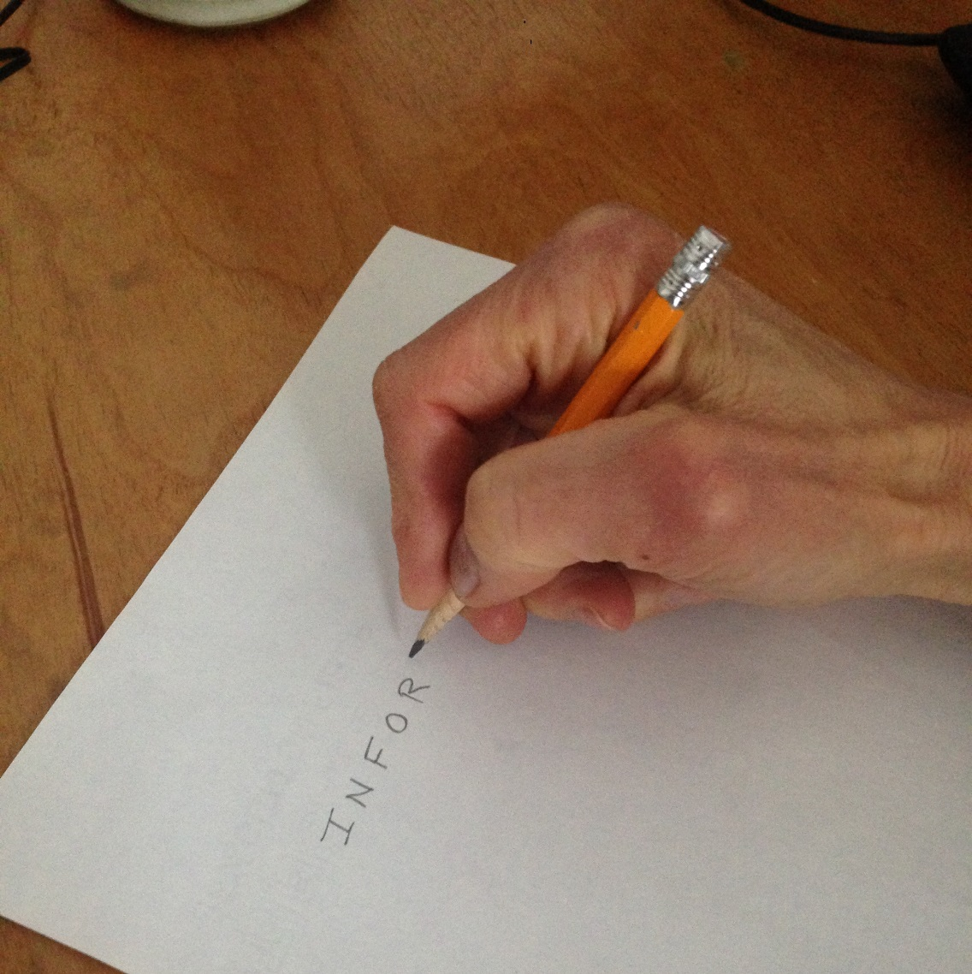
Mechanism to Write
Notes:
Consider this mechanism for writing information.
It is highly complex. The pencil has a lead and a wooden shape that allow the had to grip it. The hand has a precise size and shape and connections of bones, tendons, nerves, and muscles There is fantastic software in the brain to control it all.
Mechanisms for writing information are highly complex.

Slide 35
6 Mechanism to
write information
Notes:
Hormones for childbirth. Too soon, baby is dead. Too late, mother and baby are dead.

Slide 36
7 Guess which symbolic
Letters to use
(L, I, V, and E)
AND
arrange them
in the correct order.

Slide 37
7 Guess which
letters to use and
put them in order.
Notes:
Hormones for childbirth. Too soon, baby is dead. Too late, mother and baby are dead.

Slide 38
Create a mechanism
read and copy the info
and cell machinery

Slide 39
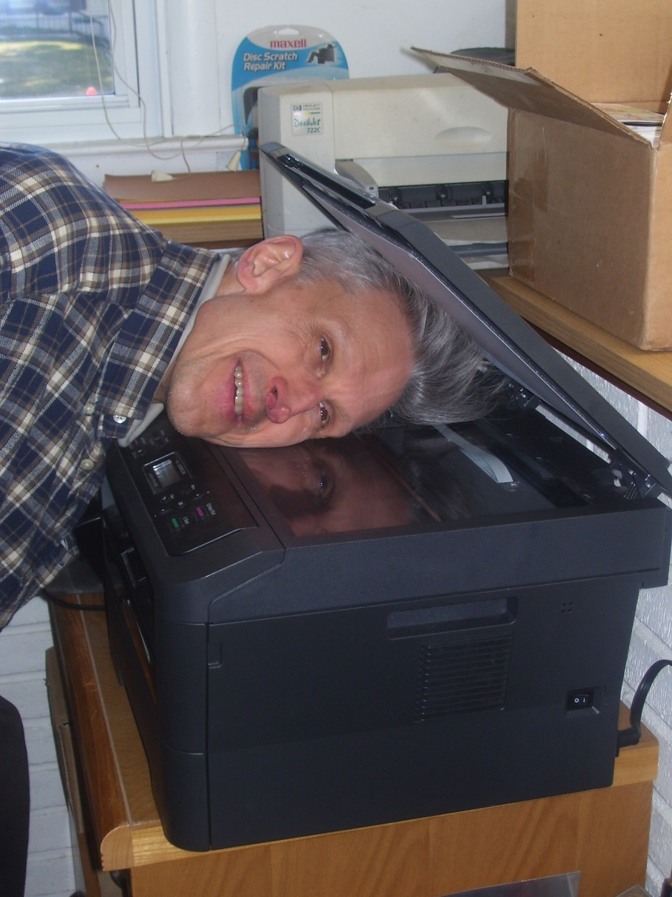
Copy Machines are Not Accidents

Slide 40
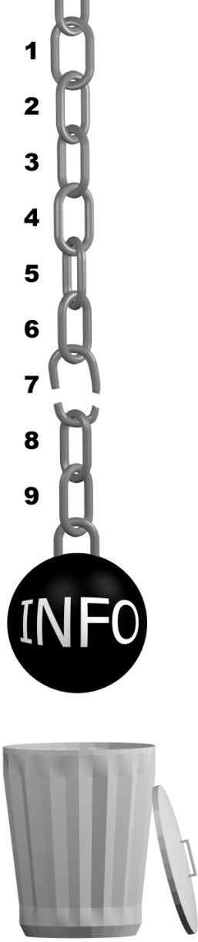

None of the 8 steps
required for
information creation
happen by chance.

Slide 41


Slide 42
Facts of Nature
1) Law of Gravity
2) Complex information is not
created by chance
Notes:
It is a fact of nature that complex information is not created by chance.
This is rigorously and mathematically provable.
In general information is not created by chance.

Slide 43
True Science
Scientific Theories Must be Testable
Must Not Contradict Known Facts

Slide 44
Problem
Evolution Requires
Information be Created by Chance
+ Natural Selection
Known Fact:
Complex Information is Not Created by Chance
Mathematically Provable

Slide 45
The Theory of Evolution is False

Slide 46
True
Survival of the Fittest
(Natural Selection)

Slide 47
True
Adaptation
Organisms can change
in response
to the environment.
Notes:
Dogs can grow longer hair in cold climates.

Slide 48
False
Evolution
New complex information can
be created by natural processes.

Slide 49
Survival of the Fittest | Removes information. | True

Slide 50
Survival of the Fittest | Removes information. | True
Adaptation | Rearranges information. Turns genes on/off. | True

Slide 51
Survival of the Fittest | Removes information. | True
Adaptation | Rearranges information. Turns genes on/off. | True
Evolution | Believes in new complex information. | False

Slide 52
See presentations:
No information by chance – DNA
From simple to complex

Slide 53
Give your own presentations.
Free downloads of PowerPoints used in these videos at:
Educate7.com

Slide 54
Next:
Are You an Accident of Nature?
Part 8
Evolution from Simple to Complex Life?

